Slide 1
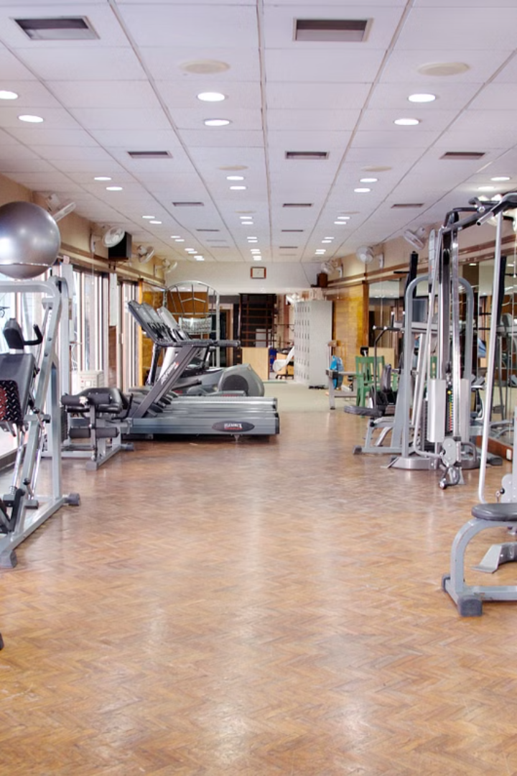
Workout Tracker
This presentation will introduce a Python script for tracking workout data. The script utilizes API integrations and a Google Sheet interface for recording and visualizing workout data.
by TEAM ALPHA-58

Slide 2

Why do we need Workout
Tracking app?
1
Manual Tracking
Manually logging workout details is tedious and prone to errors.
2
Data Visualization
Lack of efficient data visualization hinders progress analysis.

Slide 3
API Integration and Data Retrieval
Nutritionix API
Sheety API
The script utilizes the Nutritionix API to retrieve exercise data based on user input.
The script integrates with Google Sheets API to store and visualize workout data.
Exercise Name
Date
Duration (Minutes)
Time
Calories Burned
Exercise Name
Duration
Calories Burned

Slide 4
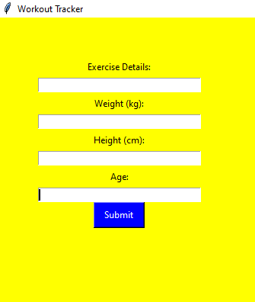



GUI Application
Tkinter Interface
A user-friendly GUI is built using Tkinter.
Input Fields
Input fields allow users to enter exercise details, weight, height, and age.
Submit Button
Clicking the submit button triggers data retrieval and logging.

Slide 5
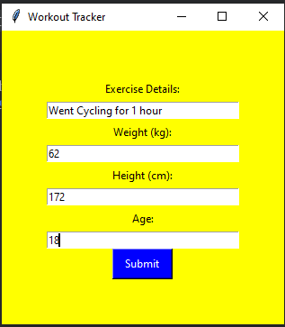
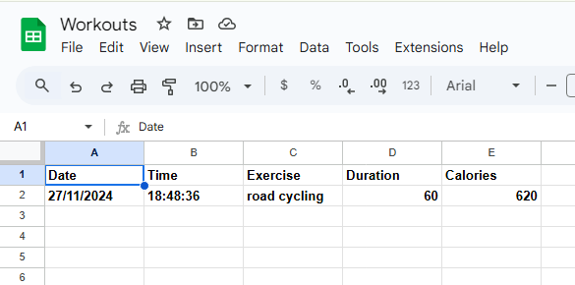
Workflow
1
User Input
The user enters exercise details, weight, height, and age.
2
API Call
The script sends a request to the Nutritionix API using the provided information.
3
Data Retrieval
The API returns exercise data, including name, duration, and calories burned.
4
Data Logging
The retrieved exercise data is logged to a Google Sheet using the Sheets API.

Slide 6


